Slide 1
R (Basic)

Slide 2
R basic command
a=1
print(a)
b="Hello"
print(b)
c = readline(prompt="Enter name: ")
sprintf("You have entered: %s", c)
e = 1
while (e<5) {
e=e+1
print(e)}
d = 1
if (d == 0)
{print("d is zero")} else if (d == 1)
{print("d is 1")} else
{print("d is not 0 or 1")}

Slide 3
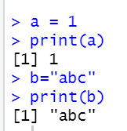
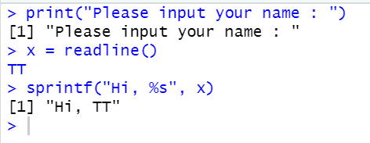
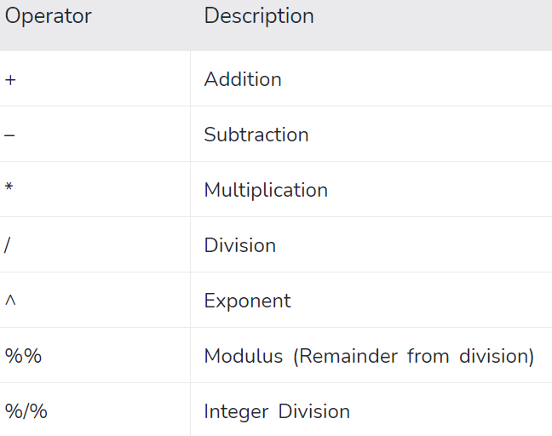
Python Simple Syntax (Variable, assign or input)
print("hello")

Slide 4
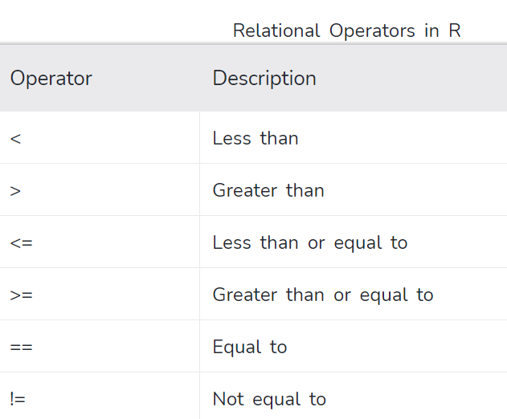
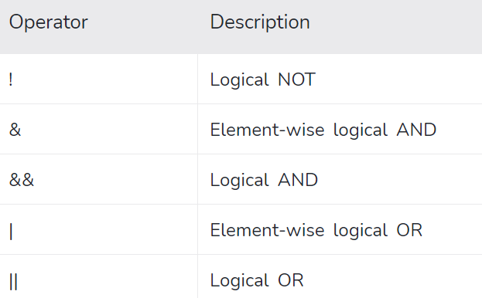
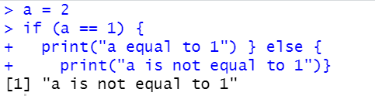
If else

Slide 5
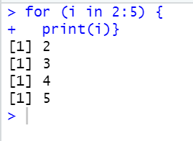
For Loop

Slide 6
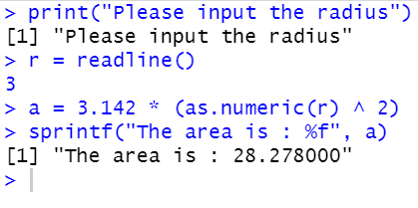
Simple task
Write a Python program which accepts the radius of a circle from the user and compute the area.

Slide 7
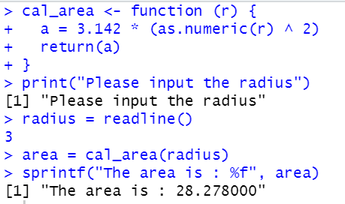
Using function

Slide 8
Read data using fread and split the data
library(data.table)
dt=fread("Treynor (Basic).csv")
library(caTools)
temp=sample.split(dt$Class, SplitRatio=0.3)
train=dt[!temp,]
test=dt[temp,]

Slide 9
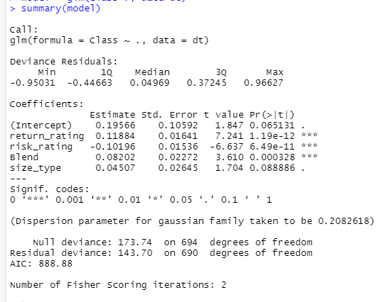
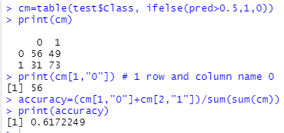
Logistic Regression
model = glm(Class~., data=train)
summary(model)
pred=predict(model, train)
print(pred)
cm=table(train$Class, ifelse(pred>0.5,1,0))
print(cm)
print(cm[1,"0"]) # 1 row and column name 0
accuracy=(cm[1,"0"]+cm[2,"1"])/sum(sum(cm))
print(accuracy)

Slide 10
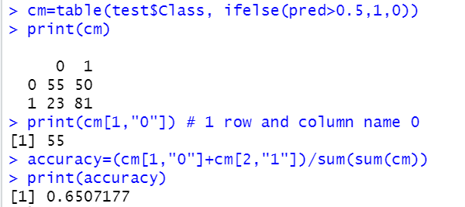
Logistic Regression – Test Set
pred=predict(model, test)
cm=table(test$Class, ifelse(pred>0.5,1,0))
print(cm)
print(cm[1,"0"]) # 1 row and column name 0
accuracy=(cm[1,"0"]+cm[2,"1"])/sum(sum(cm))
print(accuracy)

Slide 11
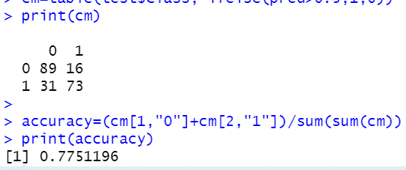
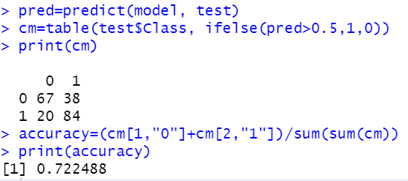
Decision Tree (Train + Test)
library(rpart)
model=rpart(Class~.,data=train)
pred=predict(model, train)
cm=table(train$Class, ifelse(pred>0.5,1,0))
print(cm)
accuracy=(cm[1,"0"]+cm[2,"1"])/sum(sum(cm))
print(accuracy)
pred=predict(model, test)
cm=table(test$Class, ifelse(pred>0.5,1,0))
print(cm)
accuracy=(cm[1,"0"]+cm[2,"1"])/sum(sum(cm))
print(accuracy)

Slide 12
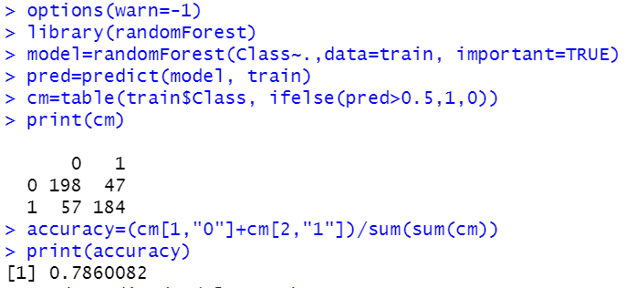
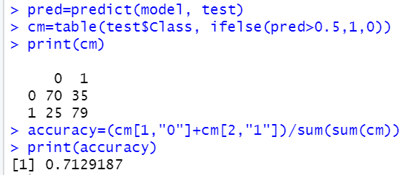
Random Forest
# install library randomForest
options(warn=-1) # remove any warning
library(randomForest)
model=randomForest(Class~.,data=train)
pred=predict(model, train)
cm=table(train$Class, ifelse(pred>0.5,1,0))
print(cm)
accuracy=(cm[1,"0"]+cm[2,"1"])/sum(sum(cm))
print(accuracy)
pred=predict(model, test)
cm=table(test$Class, ifelse(pred>0.5,1,0))
print(cm)
accuracy=(cm[1,"0"]+cm[2,"1"])/sum(sum(cm))
print(accuracy)

